Slide 1
Segment-sheet
File created on: 1/9/2024 6:54:32 PM

Slide 2
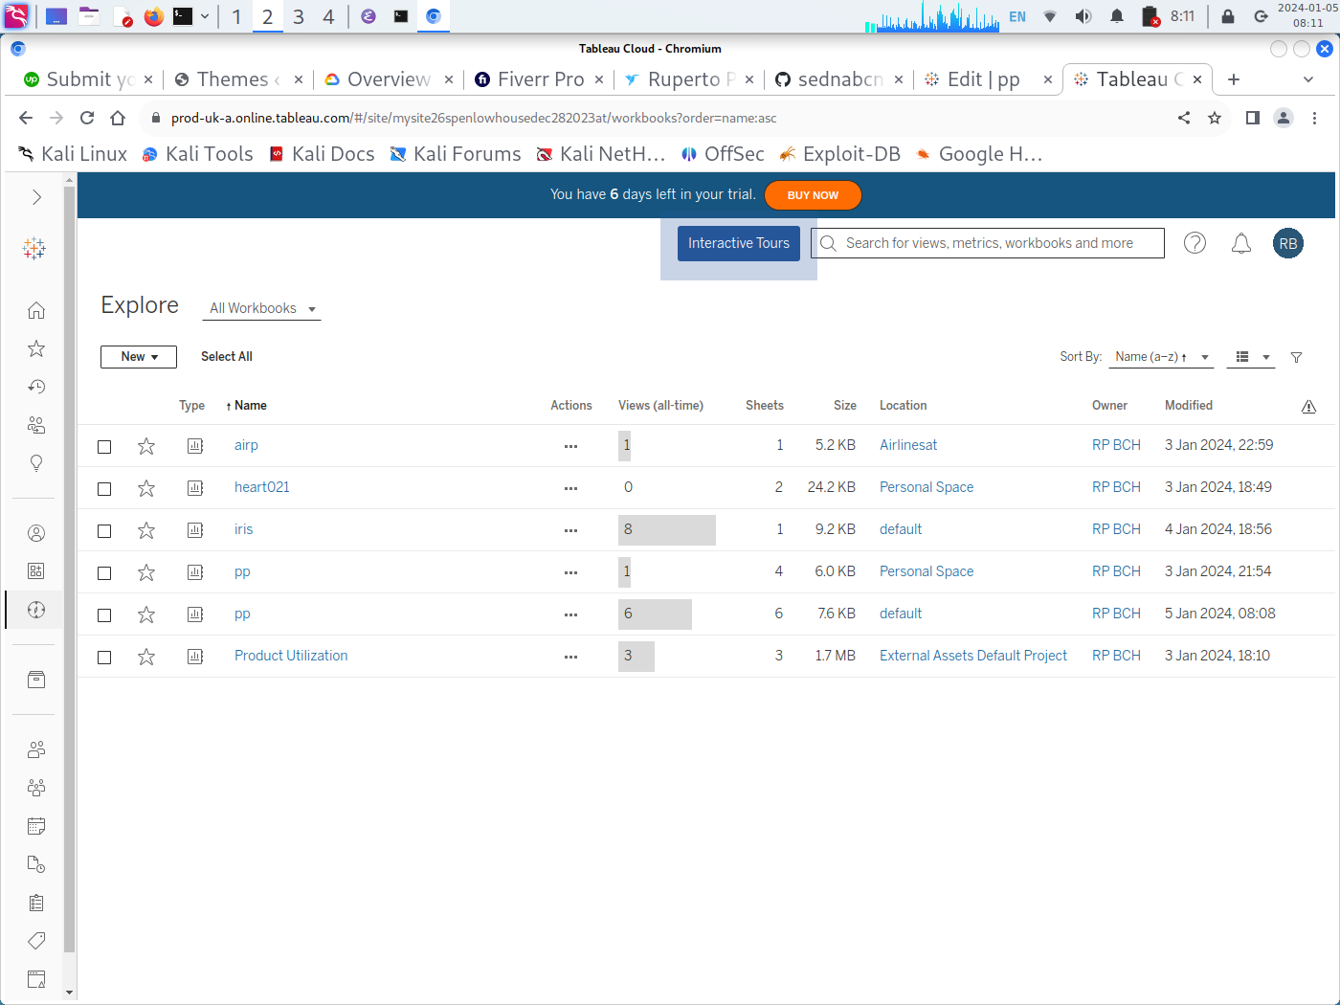
EXPLORE ON WORKBOOKS

Slide 3
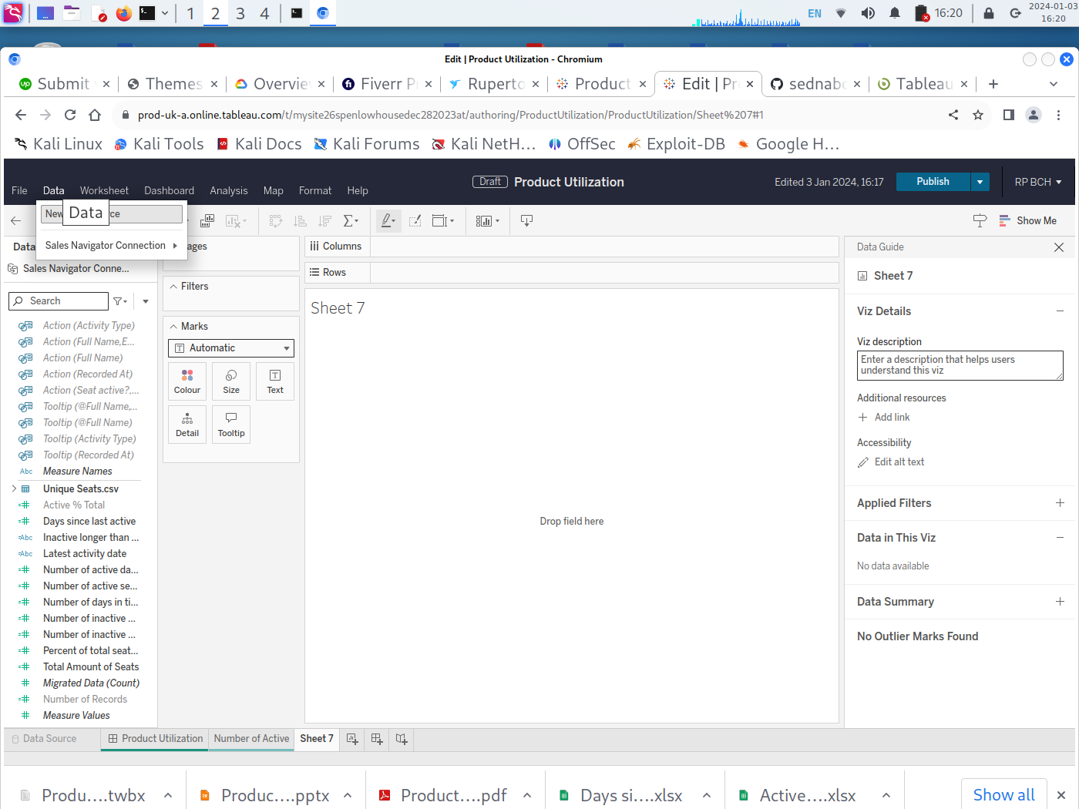
DATA VIEWS

Slide 4
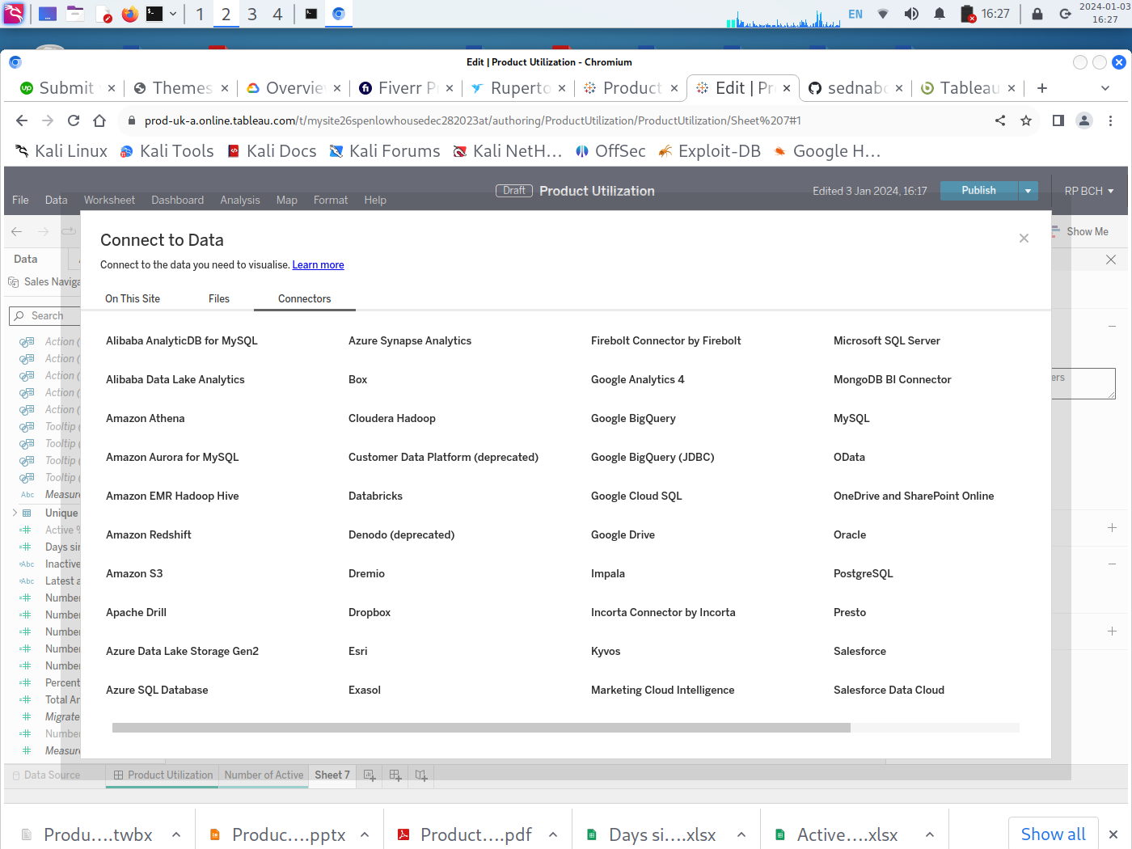
CONNECT TO DATA

Slide 5
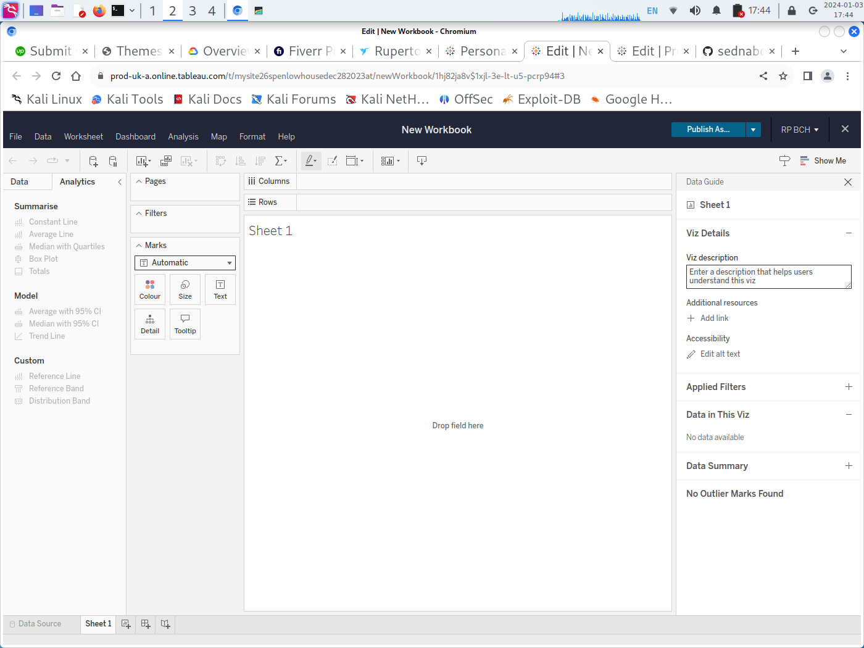
EDIT WORKBOOK

Slide 6
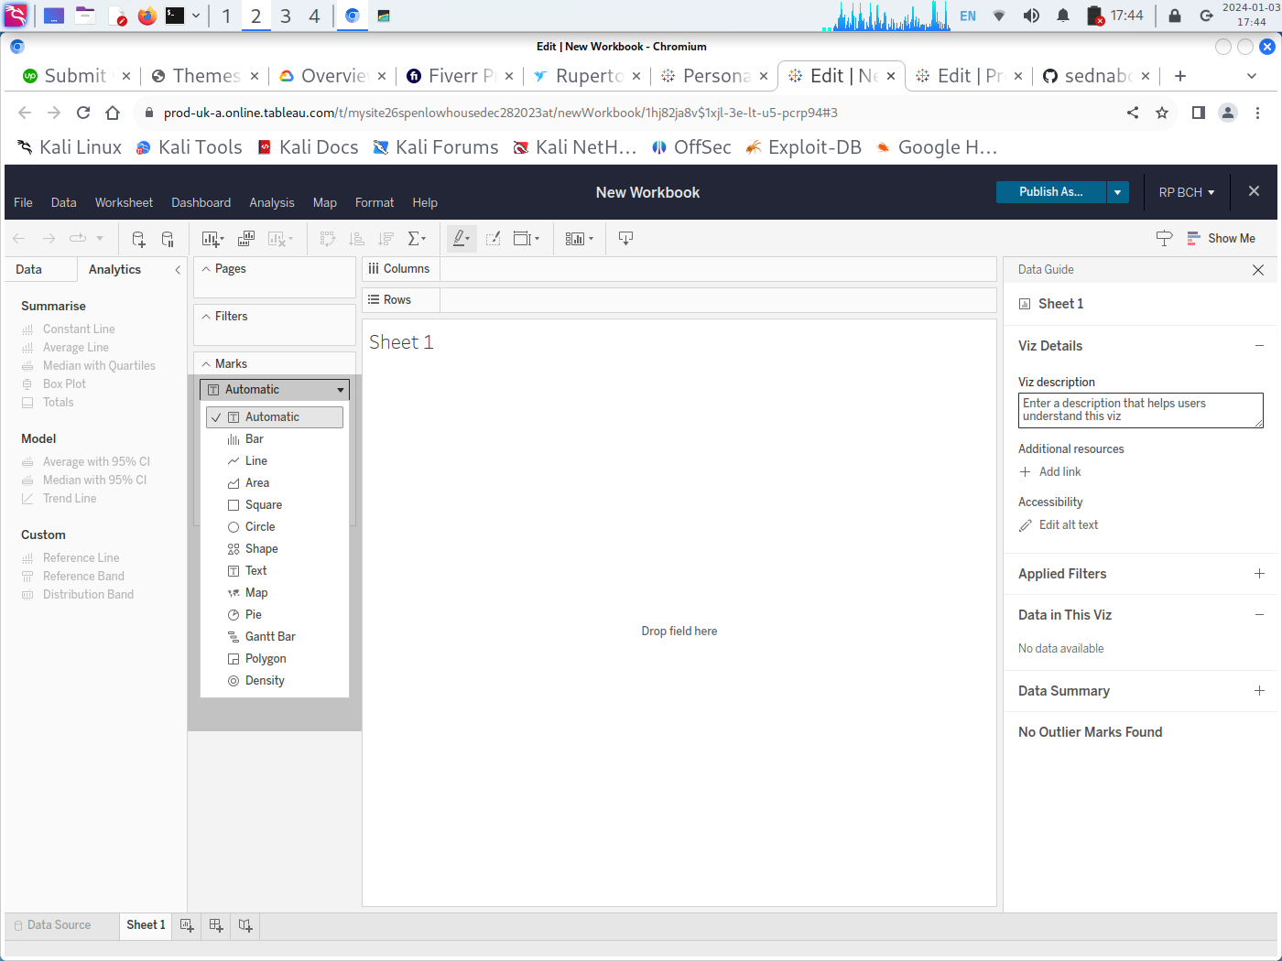
PAGES, FILTERS AND MARKS

Slide 7
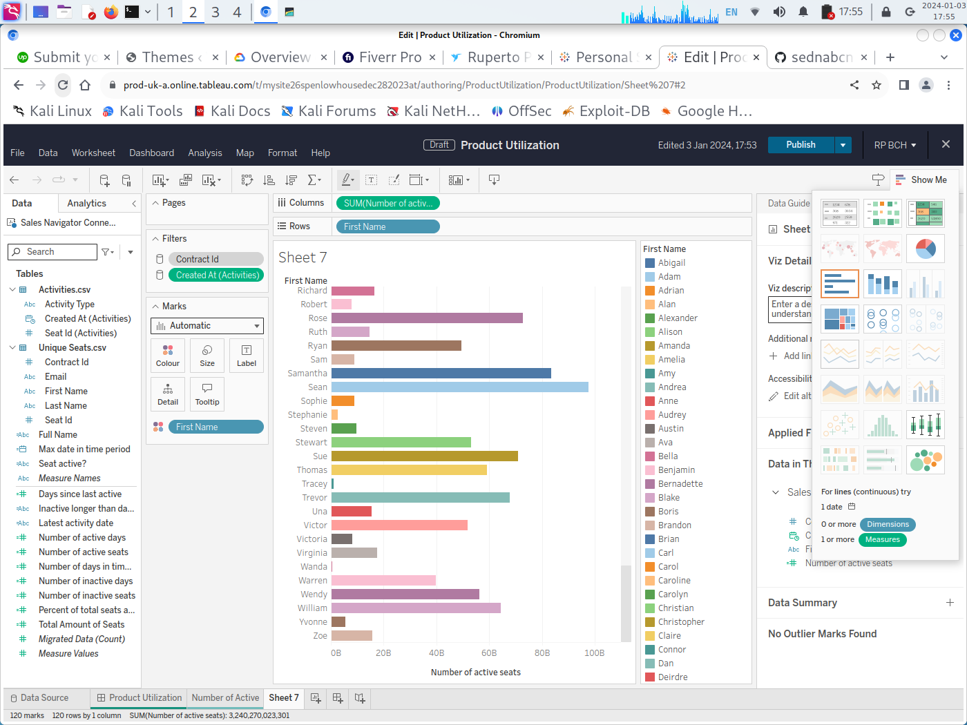
SELECTION OF CASE

Slide 8
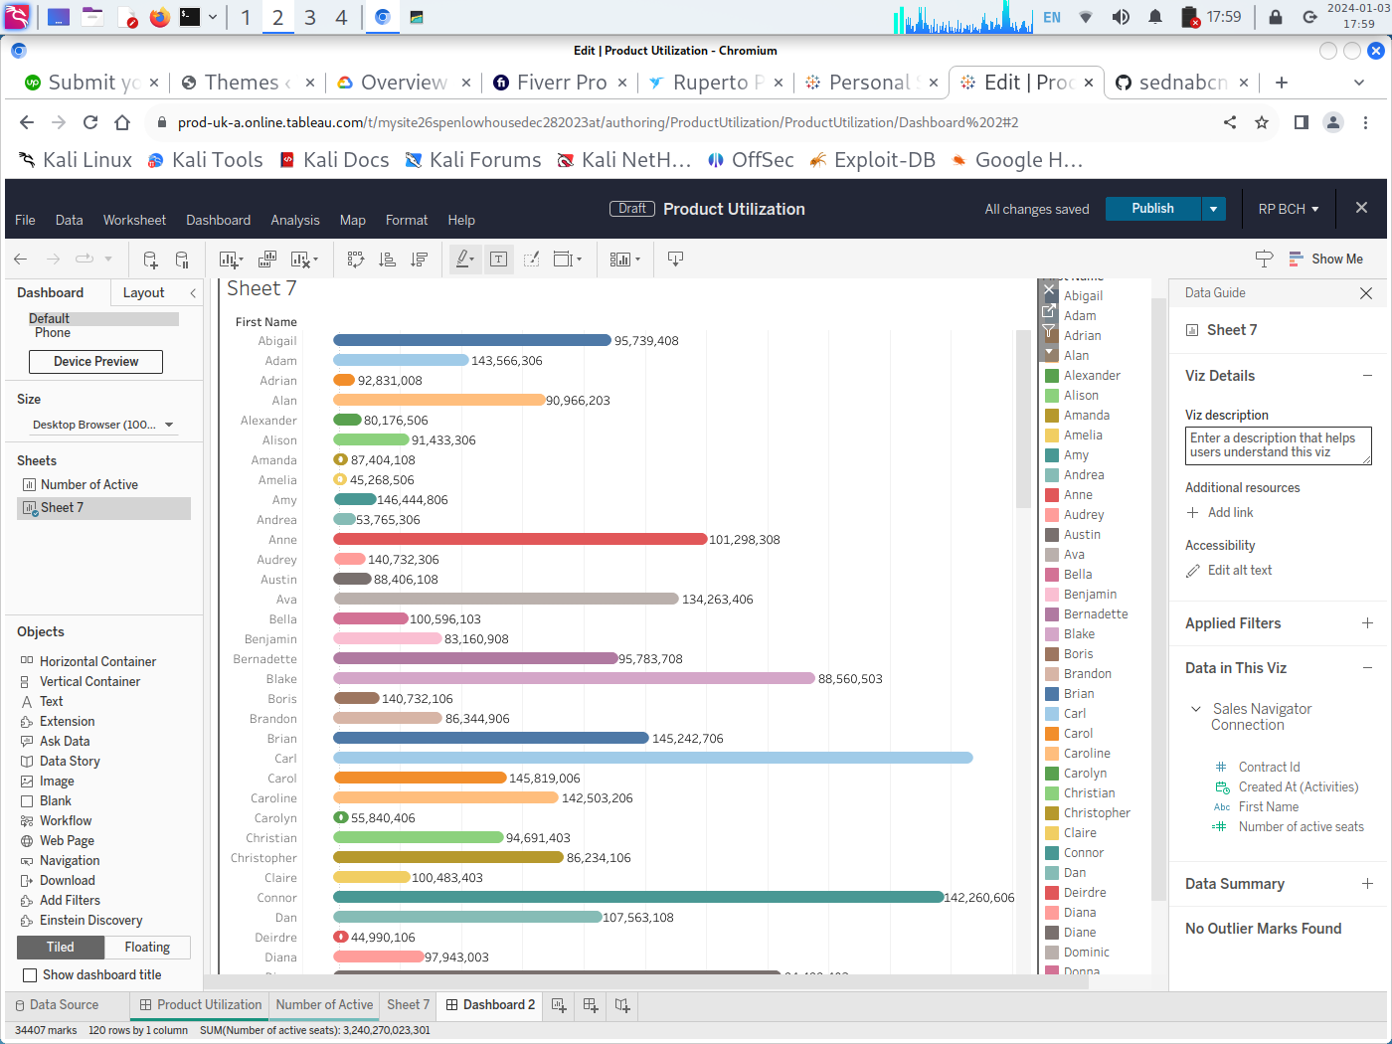

Slide 9
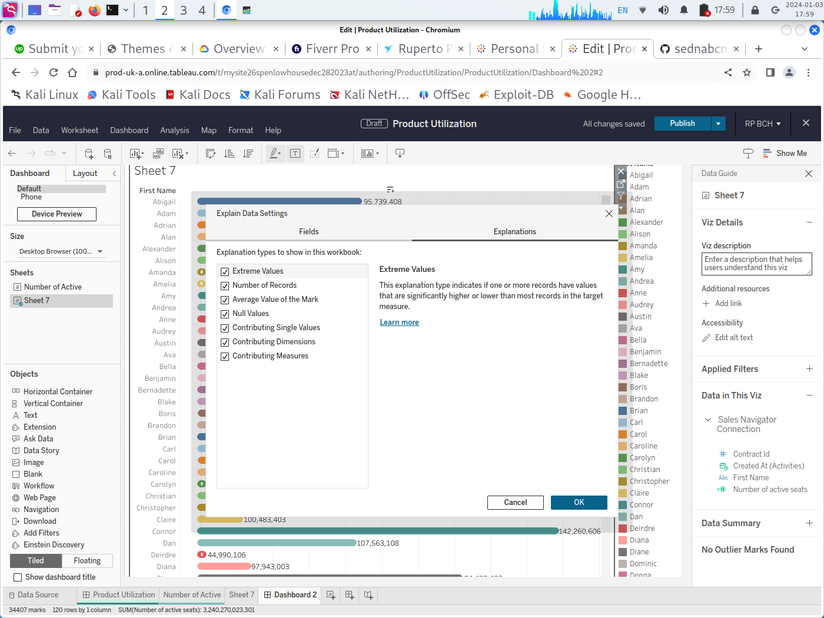
EXPLAIN DATA SETTINGS

Slide 10
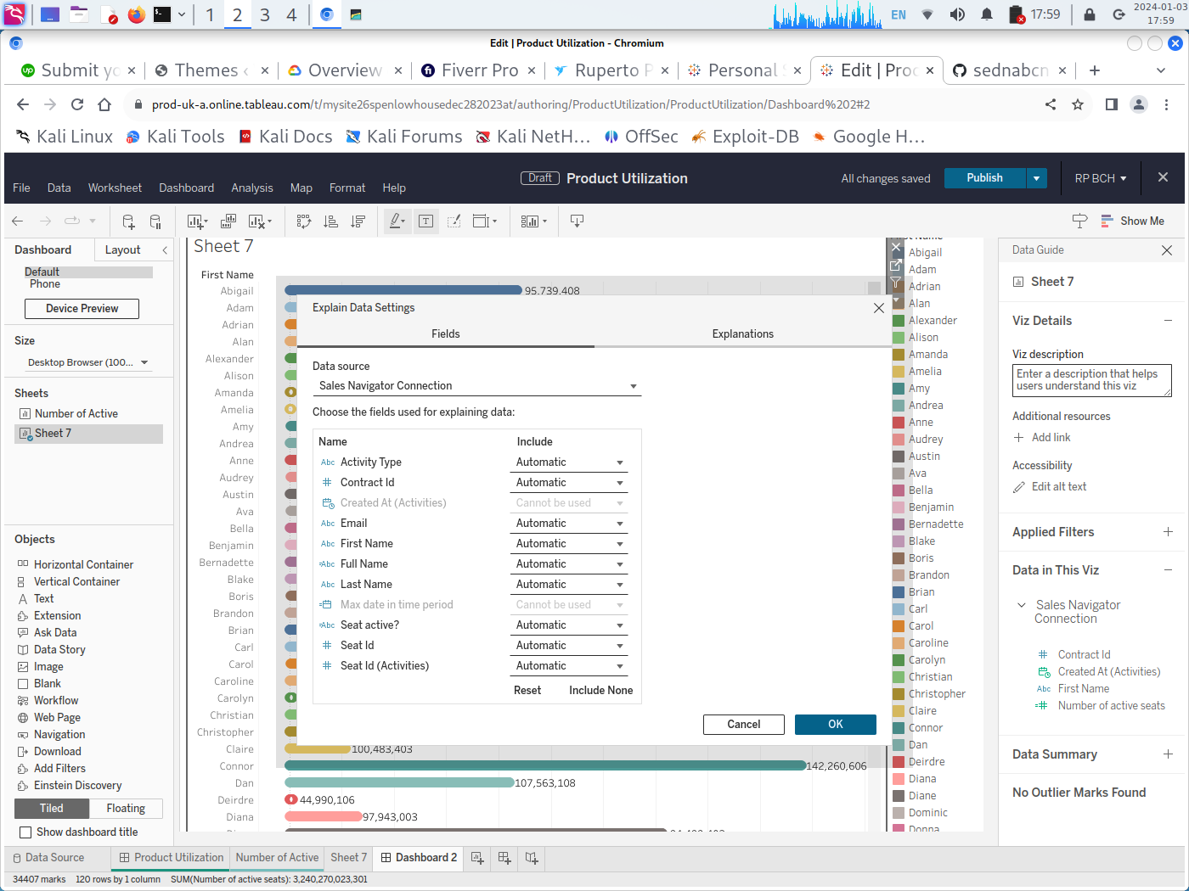
EXPLAIN DATA SETTINGS

Slide 11
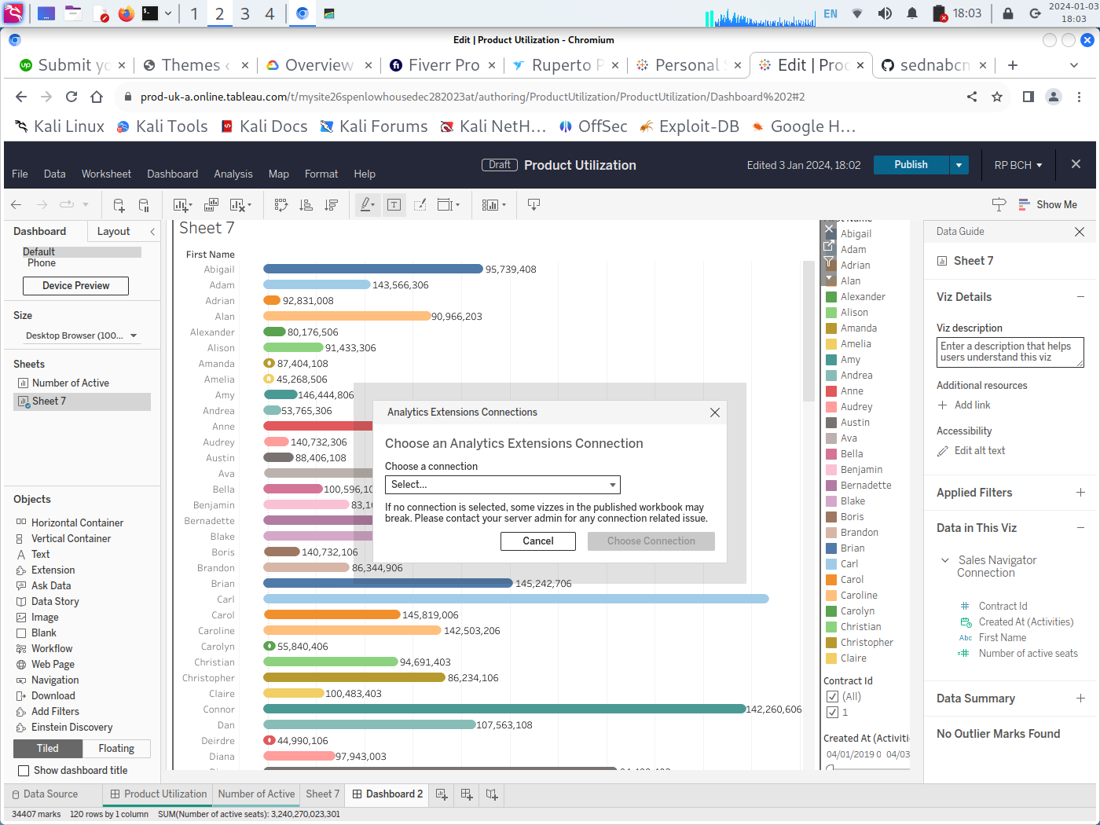
ANALYTICS EXTENSIONS CONNECTIONS

Slide 12
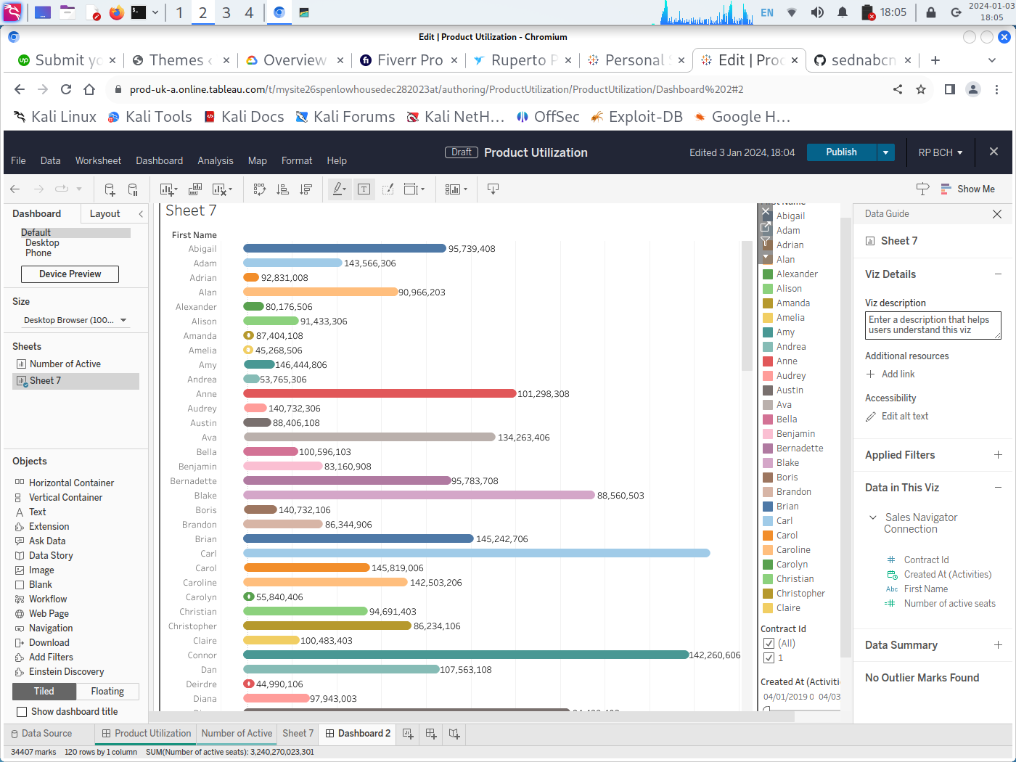

Slide 13
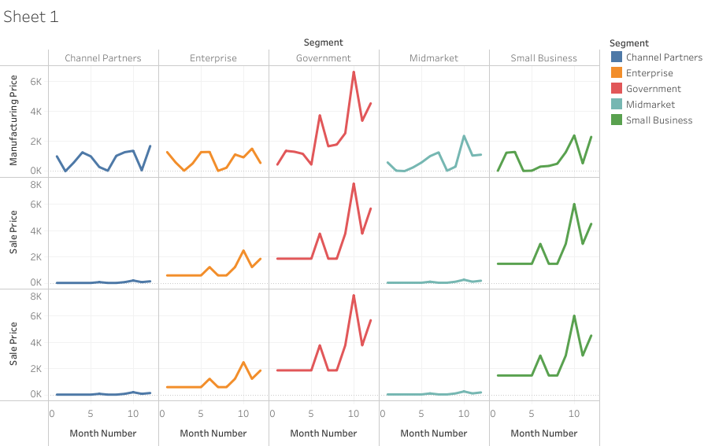

Slide 14
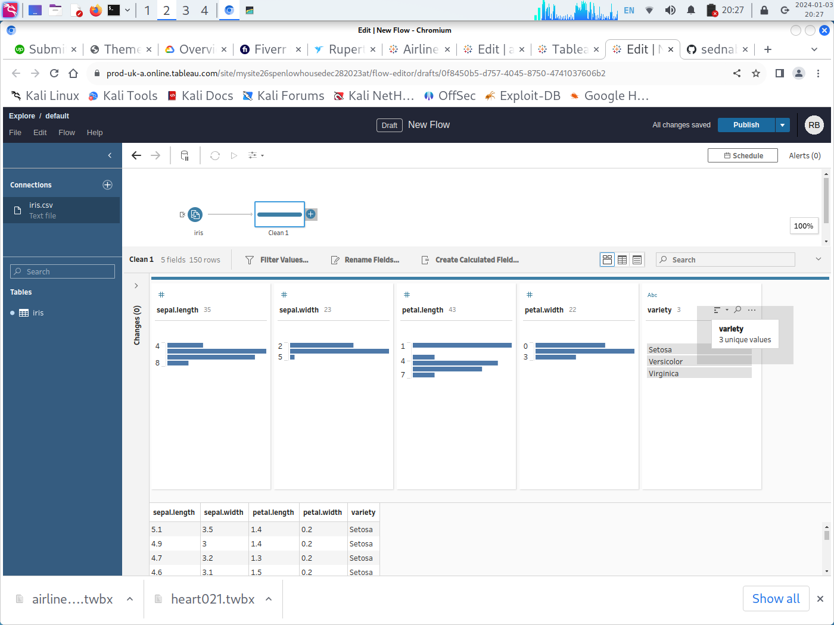
Iris Dataset

